Slide 1
MindGames
MIDTERM PROJECT REPORT
4/5/2022
Brandon Knotek (bk11@hood.edu) Walid Muhammad (wm5@hood.edu) Jack Wilder (jmw38@hood.edu)
Notes:
Table of Contents: Project Goal (locked in syndrome), background on EEG, our plan, overview (pipeline, backend, frontend), pipeline overview (data acquisition, preprocessing, classification, output), lessons learned from other groups (better hardware), how we worked together, what is next (end to demo)

Slide 2
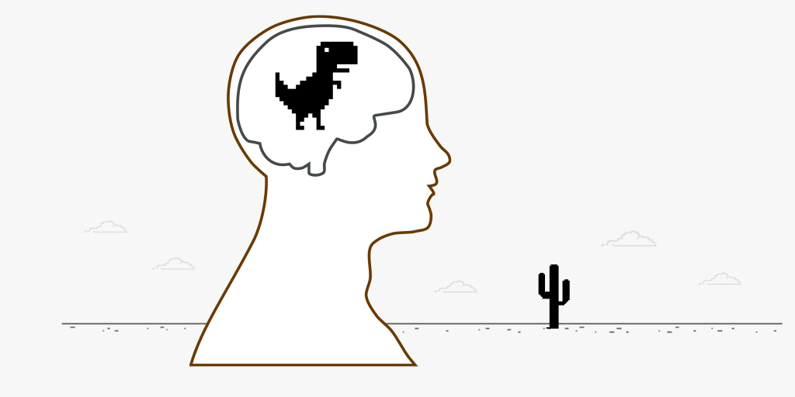
Our Idea
Enhance Accessibility
Efficient Usage and Setup

Slide 3
Why Bother?
Motor-Limiting Diseases/Injuries
Communication Improvement
Muscle Activation is Nearly Universal
Notes:
Locked-In Syndrome

Slide 4
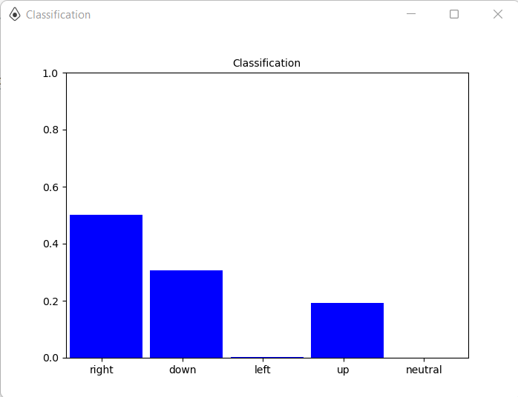
Unraveling the Brain
Electroencephalography (EEG)
Data and Signal Processing
Notes:
Different regions of the brain produce different signals that can be classified into different types (gamma, delta, etc.) we are mainly focused on movement and this produces a specific collection of these types of brain waves which through training are associated with an instruction

Slide 5
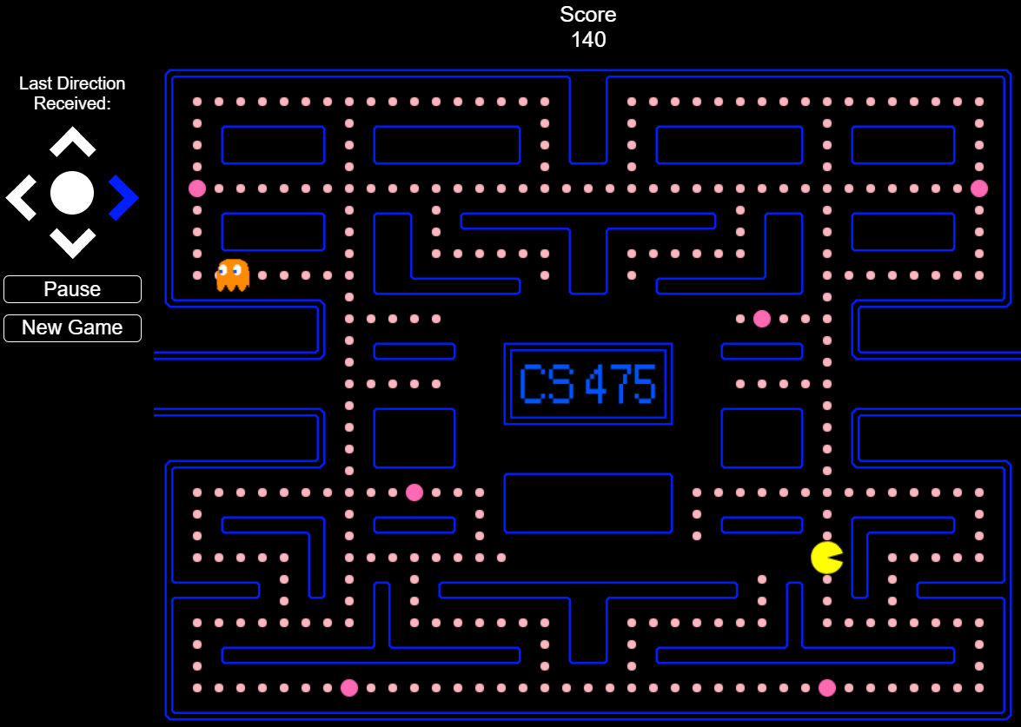
Mental Control - Not Just Sci-Fi
Not a Universal System Immediately
Training Modules
Continuous Comparison
Notes:
Each brain pattern for a specific instruction will be different, we’ve run through a number of training modules, some more effective than others, once it is successful a live comparison is made when playing Pac-Man to training data to see if game should actually send right, left etc action

Slide 6
Our Plan
Configure Headset
Develop Efficient Method for Training
Transmit Matched Commands to Pac-Man

Slide 7
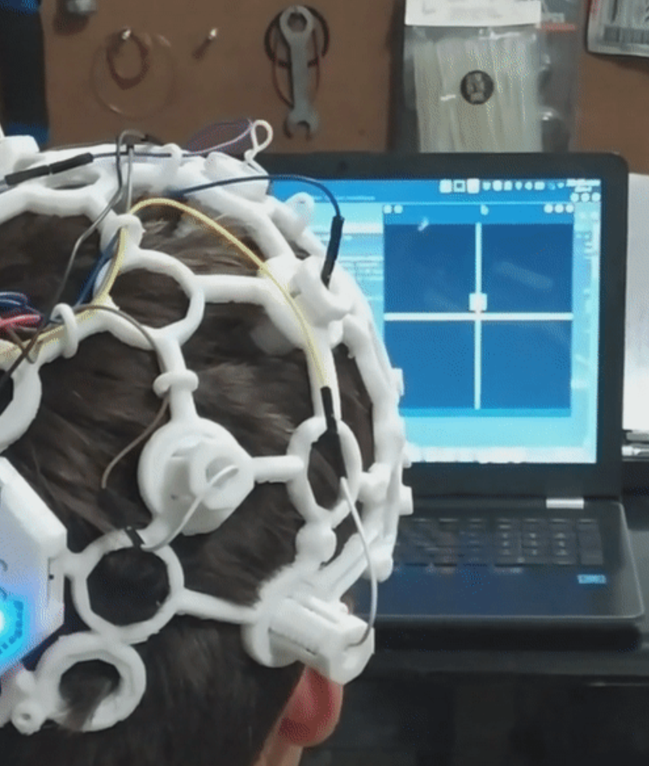
Previous Solutions
Citation: https://github.com/CrisSherban/BrainPad#readme
Bigger, More Complex Systems
Generalized Signal Processing
Notes:
Generally not a high degree of certainty even with just choosing between 2 instructions (all mental commands no movements) Other companies have many more resources than we do, for instance some places have 32 nodes in their headsets as opposed to our 8 working ones and our headset takes in a lot of noise as evidenced by one training session in a room bombarded with some sort of electromagnetic waves (could continue talking about other finished products)

Slide 8
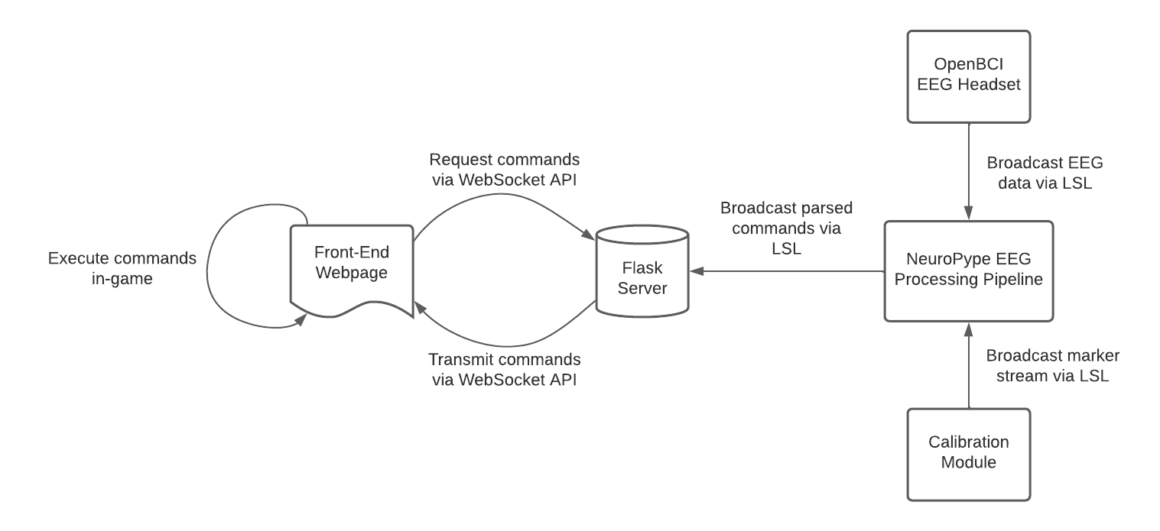
System Overview
Notes:
Brandon for slides 8/9 ?

Slide 9
Communication Protocols
Bluetooth
EEG data (external)
LSL (Lab Streaming Layer)
EEG data (internal)
Marker stream
WebSocket
Parsed commands
Notes:
LSL built specifically for experimental results are live

Slide 10
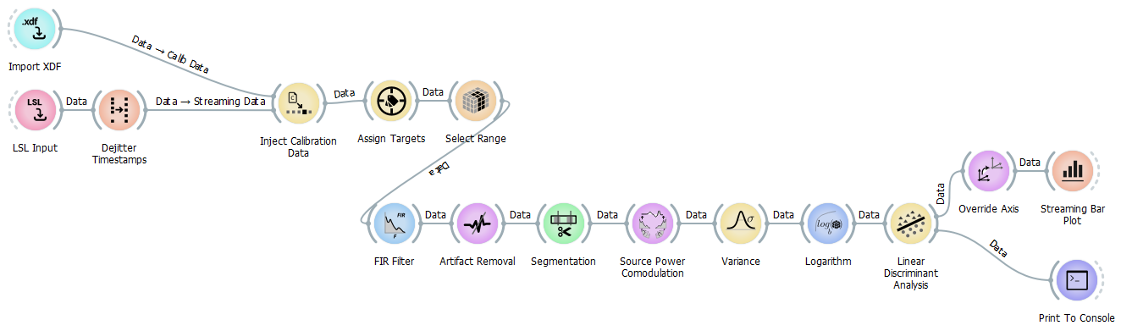
Accomplished Work
Configuration/Training
Pipeline Connections
Pac-Man
Notes:
(add image of histogram with possible actions)

Slide 11
Development Dynamics
Each Member Excelled in Certain Areas
Consistent Group Meetings
Individual Methodologies
Notes:
Have a table with the team members, roles (who did what) Jack- 20 hours Liason and Organizationally Focused, Brandon- 35 hours Coding Lead, Walid- 20 hours Theory/Research Lead and hours spent. How did the team operate? (meetings, communication, task assignment, etc). Development or experimentation methodology and why it was selected. Subdivision of tasks What worked well about the methodology, what didn’t, Tools used for the development and experimentation effort. Drive Licensed software, discord meetings

Slide 12
Lessons Learned
Importance of Subdivision of Tasks
One Step at a Time
Development Needs a Large Breadth
Notes:
Problems with robustness of hardware, cant differentiate between certain signals that are similar: right/left, lots of noise more and better electrodes
This is a technical/scientific lessons-learned. Explain what has gone right and why, what has gone wrong, and why. What would you do differently, why and how?

Slide 13
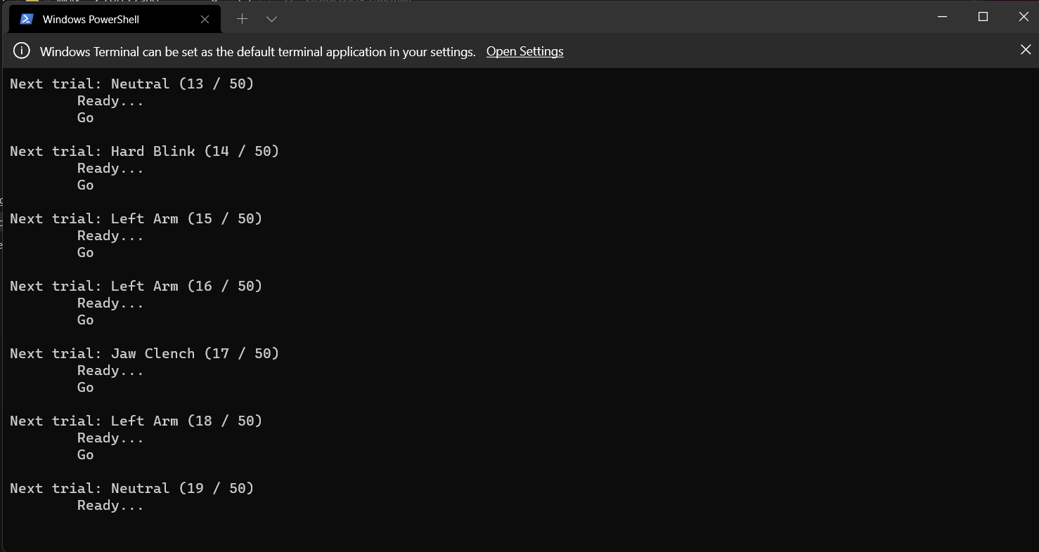
What’s Left?
Refinement of Signal Processing
Expansion of Applicable Movements
New and Different Real-World Applications
Notes:
List of what is left to do, how will you accomplish it, and by when

Slide 14
Questions?

